Slide 1
4483/8995 CAPSTONE PROJECT PRESENTATION
Exploring the Iris Dataset: EDA, Classification and GUI Application
STUDENT NAME: Mohammad Faisal
Student ID: u3212031

Slide 2
Table of Contents
Introduction / Problem Statement
Dataset Details
EDA (Exploratory Data Analysis) Outcomes
PDA (Predictive Data Analytics) Outcomes
Implementation and Deployment (TkInter/Flask/Streamlit) Plan and Status Update
References/Bibliography

Slide 3
Introduction / Problem Statement
In this presentation on my analysis of the Iris dataset and the development of a predictive model for its species classification.
The Iris dataset is a well-known dataset in the field of machine learning and data analysis, and it contains measurements of various features of different Iris flower species. In this presentation, I will walk you through our exploratory data analysis (EDA) of the dataset, where we have looked at different characteristics and patterns in the data.
I will also present our approach for developing a predictive model using a decision tree classifier, and we will demonstrate how we can use this model to classify new Iris samples based on their features.
Finally, we will showcase our efforts in creating a desktop GUI application using Python's Tkinter library and a web application using Streamlit.
We hope you find this presentation informative and interesting.

Slide 4
2. Dataset Details
The Iris dataset is a classic dataset used in machine learning and statistics. It contains information on three species of the Iris flower (Iris setosa, Iris versicolor, and Iris virginica) with 50 samples for each species.
The dataset includes four features of each sample: sepal length, sepal width, petal length, and petal width. The dataset is often used for classification tasks, where the goal is to predict the species of a new flower based on its features.
Iris dataset

Slide 5
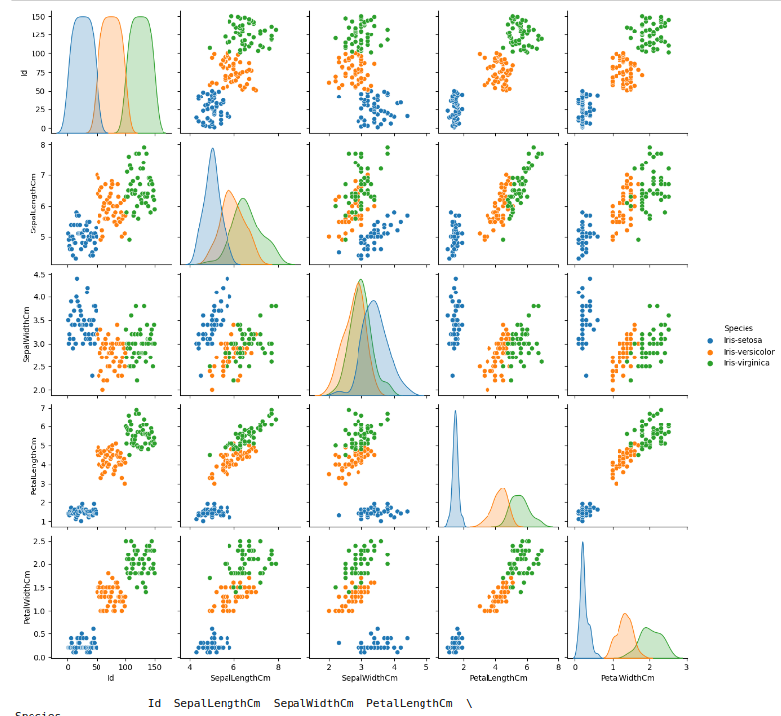
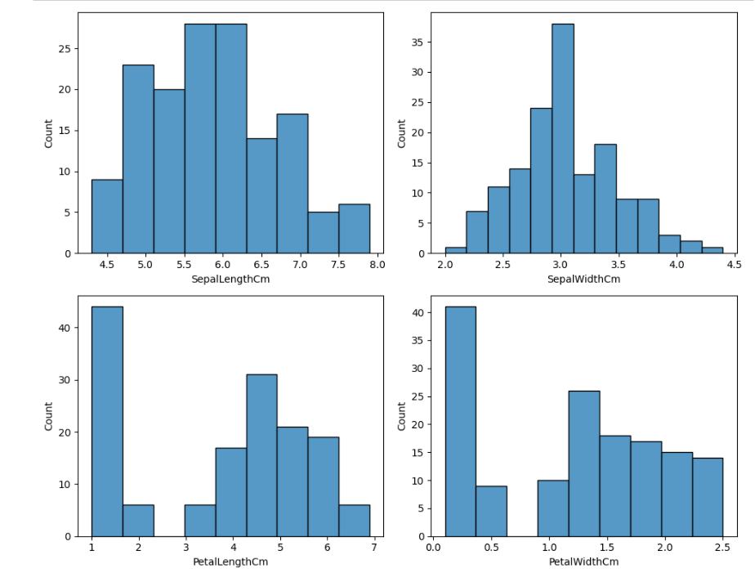
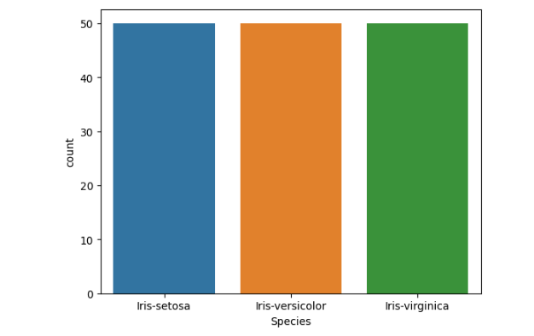
3. EDA (Exploratory Data Analysis) Outcomes
The average sepal length and width of the flowers are 5.8 cm and 3.1 cm, respectively. The average petal length and width are 3.8 cm and 1.2 cm, respectively.
The petal length and width are highly correlated, while the sepal length and width have a weaker positive correlation.
The setosa species can be easily separated from the other two species based on their petal length and width, while versicolor and virginica have some overlap in their feature distributions.

Slide 6
4. PDA (Predictive Data Analysis) Outcomes
As our project focuses on classification of iris plants based on their sepal and petal dimensions, the PDA outcomes involve the performance of different machine learning models on the dataset.
The performance of different classification models -Logistic Regression, K-Nearest Neighbors, Decision Tree, and Random Forest on the iris dataset was evaluated using 10-fold cross-validation, with Random Forest performing the best with an average accuracy of 96.67%.
Recursive Feature Elimination (RFE) with Logistic Regression as the underlying model revealed that petal length and petal width were the most important features for iris classification.
Overall, these findings suggest that the different features of the iris flowers can be used to accurately classify the different species.

Slide 7
5. Implementation and Deployment (TkInter/Flask/Streamlit) Plan and Status Update
For the deployment plan,
Create a desktop application using the Tkinter library for the decision tree model, and a web-based application using the Streamlit library for the support vector machine model. Both applications will allow users to input values for the four iris features, and the model will output the predicted class.
Currently, the implementation phase for both the desktop application and web-based application has been completed. The desktop application has been developed using Python and Tkinter, while the web-based application has been developed using Python and Streamlit. Both applications have been tested and validated with the iris dataset, and the accuracy of the machine learning models has been confirmed

Slide 8
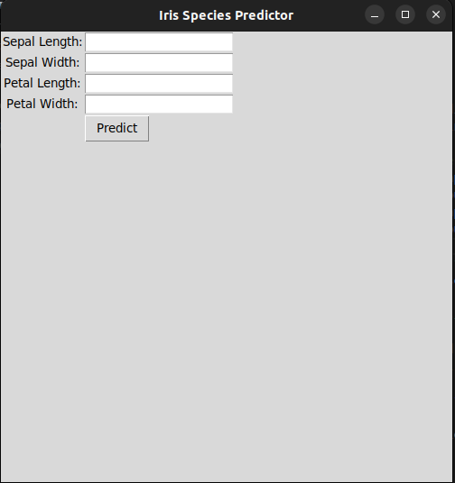
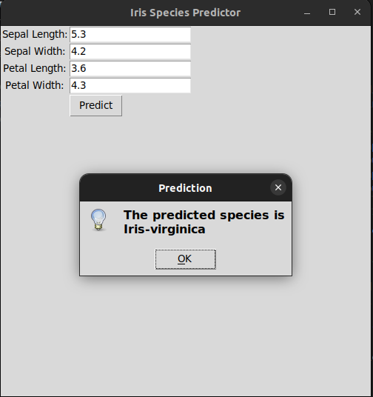
5. Implementation and Deployment (TkInter/Flask/Streamlit) Plan and Status Update(Screenshots)
Desktop GUI app

Slide 9
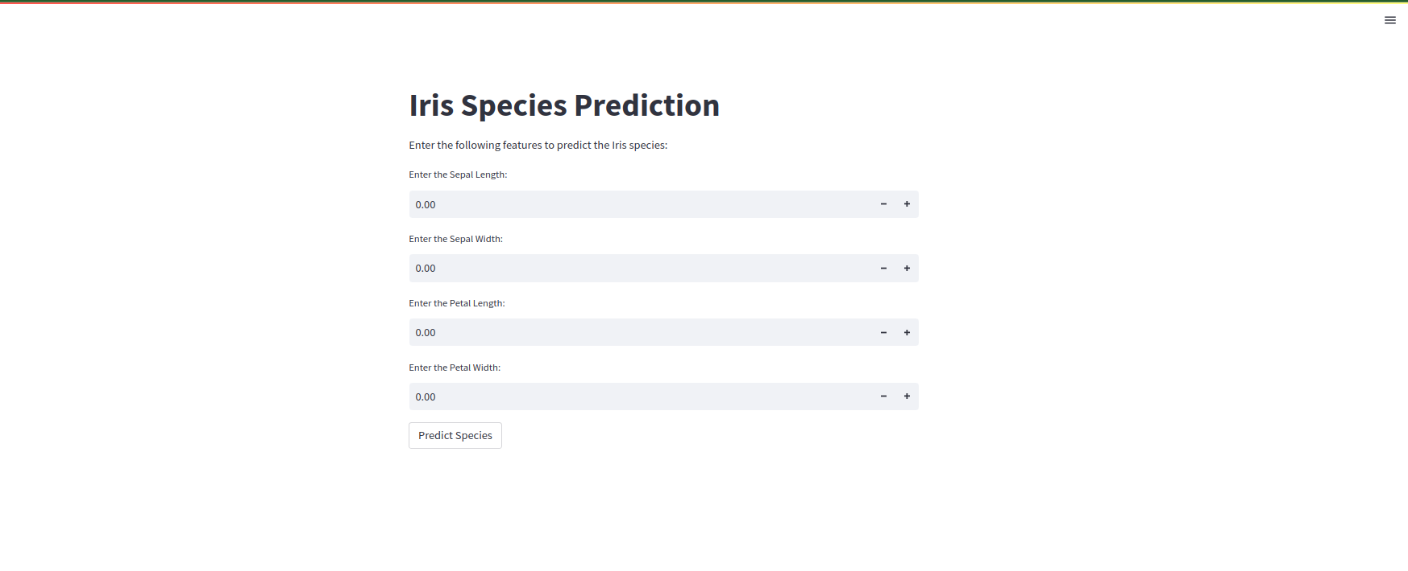
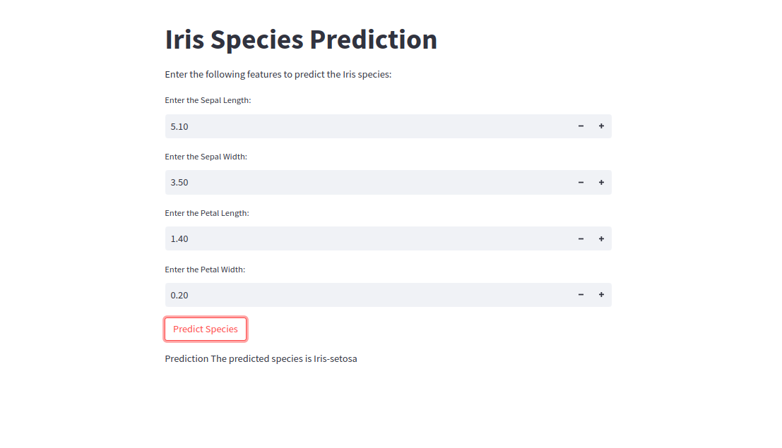
5. Implementation and Deployment (TkInter/Flask/Streamlit) Plan and Status Update(Screenshots)
Streamlit App

Slide 10
References /Bibilography
Brownlee, J. (2020). How to Develop a Multiclass Classification Model for Iris Flower Species. Retrieved from https://machinelearningmastery.com/how-to-develop-a-multiclass-classification-model-for-iris-flower-species/
Hastie, T., Tibshirani, R., & Friedman, J. (2009). The elements of statistical learning: data mining, inference, and prediction. New York: Springer.
https://www.kaggle.com/datasets/uciml/iris?resource=download
"Building Machine Learning Applications with Streamlit" by Abhishek Thakur: https://towardsdatascience.com/building-machine-learning-applications-with-streamlit-667cef3e0f1a

Slide 11
Thank you for your attention.

